Slide 1
Community detection: Clique percolation Method

Slide 2
Community
A community is defined as a subset of nodes within the graph such that connections between the nodes are denser than connections with the rest of the network.
People with similar interest usually form a part of community and one person can be a part of many communities.

Slide 3
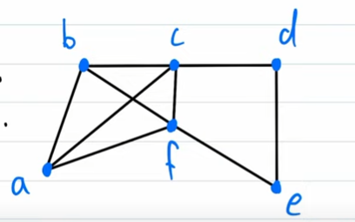
Clique
A set C is a clique of the graph G(V,E)
iff C ⊆ V(G) and (u, v) ∈ C and u ≠ v ⇒ (u, v) ∈ E(G)
In the example, (a,b,c,f) constitutes a clique.
It can be called as 4-cliques since it has 4 nodes in it.
However, (c,d,e,f) is not a clique, since there is no edge between e and C ; f and d.
Similarly, (abc), (abf), (bcf) and (acf) are 3-cliques of the given graph.

Slide 4
Clique Percolation Method
The clique percolation method is as follows:
1) All K cliques present in graph G are extracted.
2) A new clique graph GC is created -
a) Here each extracted K - CLIQUE is compressed as one vertex.
b) The two vertices are connected by an edge in GC if they have k - 1 common vertices.
3) Connected components in GC are identified.
4) Each connected component in GC represents a community
5) Set C will be set of communities formed for G.

Slide 5
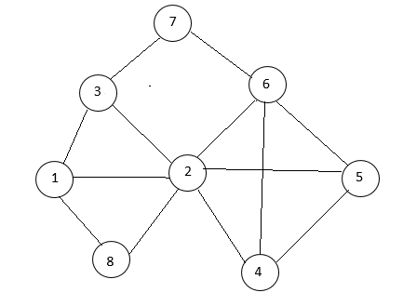
Example 1
Step 1
Let us start finding K- cliques starting with K =3
There are 6 number of 3-cliques and only one 4 – clique for the given graph.
The six no of 3 cliques as:
a : {1,2,3}
b : {1,2,8}
c : {2,4,5}
d : {2,4,6}
e : {2,5,6}
f : {4,5,6}
It has one 4 clique as:
g : {2,4,5,6}

Slide 6
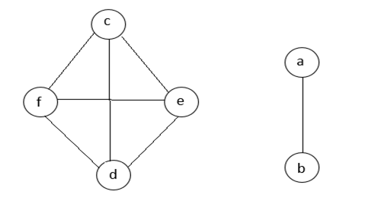
Step 2 and 3:
Construction of a clique graph (GC) and identify the connected components
The two vertices are connected by an edge in GC if they have k - 1 common vertices.

Slide 7
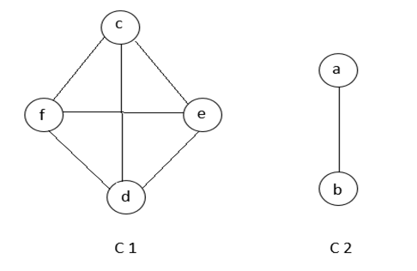
Step 4:
Mark Every connected component as a community.

Slide 8
Step 5
Identifying the communities.
Communities = {1,2,3,8},{2,4,5,6}

Slide 9
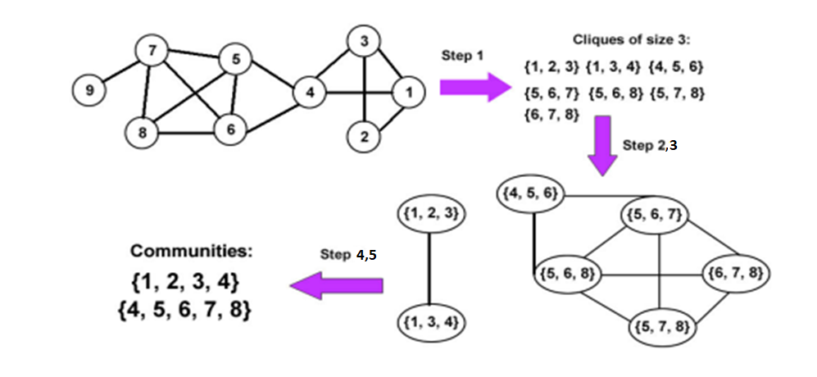
Example 2

